Slide 1
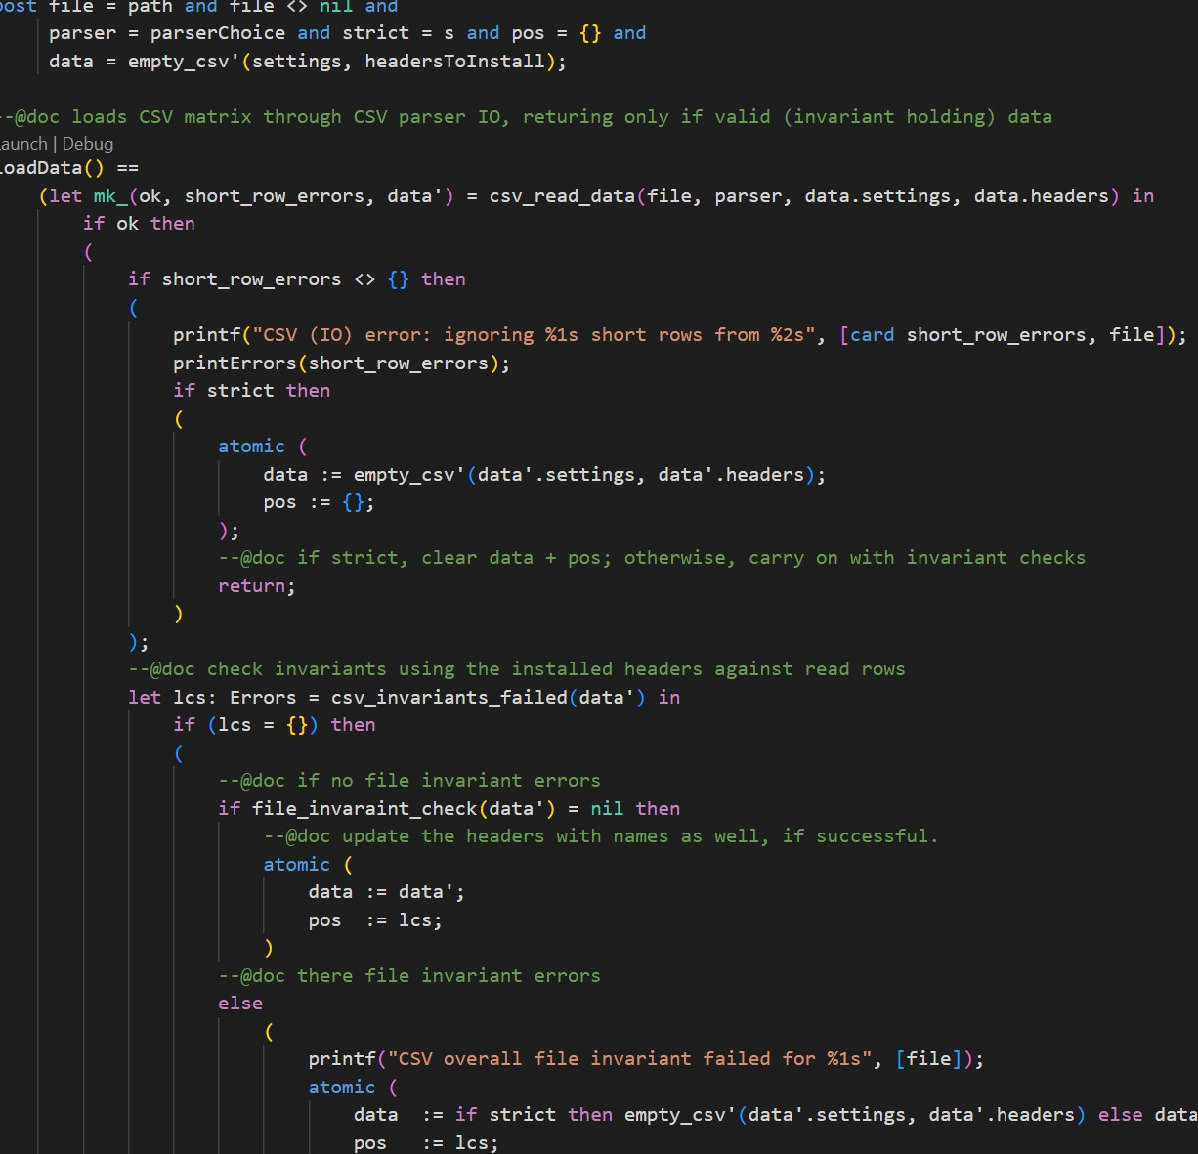

Specification-based CSV Support in VDM
The 21st Overture Workshop
10th March 2023
Leo Freitas¹
Aaron John Buhagiar²
1. School of Computing, Newcastle University
2. Translational and Clinical Research Institute, Newcastle University

Slide 2


Introduction
Standard (RFC4180) data exchange format
Ubiquitous use in a myriad of domains
Data science applications
Medical data and embedded
Payment systems
Many variations and versions are used
VDM standard CSV has limitations
We created an improved CSV library with:
Data validation formal specification
Ease-of-use
High performance
Distributed with the VDM Toolkit [1]
[1] https://github.com/leouk/VDM_Toolkit
Notes:
General background and the importance of good/correct CSV import
Variability of format
Limitations of current system
New library focused on correctness ease-of-use and performance
Distributed as part of the VDMToolkit

Slide 3

VDM standard CSV Library
Slow and error-prone (e.g. low-level IO)
Line-by-line parsing in VDM
Limited support for various CSV formats
Only hard-coded IO native calls available
Limits CSV performance and formats variety
Imported data is of a wildcard (?) type
Users have to further introspect meaning
Different from CSVReader
CSV as user data not structural information
Notes:
Implementation reads line by line bouncing between VDM and the underlying java implementation
No way of specifying CSV column data type makes parsing brittle
Library requires knowledge of how VDM-Java works as only native calls are available
The resultant data from the import is a wildcard
CSVReader creates a VDM model depending on certain CSV features. This is useful say for reading things like dialyser embedded finite state machine as a VDM type, not as CSV data!

Slide 4
Design Principles
S
A
F
E
imple
ccurate
ast
ffective
Notes:
Simple: keep IO and data manipulation out of the day-to-day picture
Accurate: have various formal invariants to guarantee things
Fast: allow for variety of high performance CSV parsers (not hard coded IO)

Slide 5
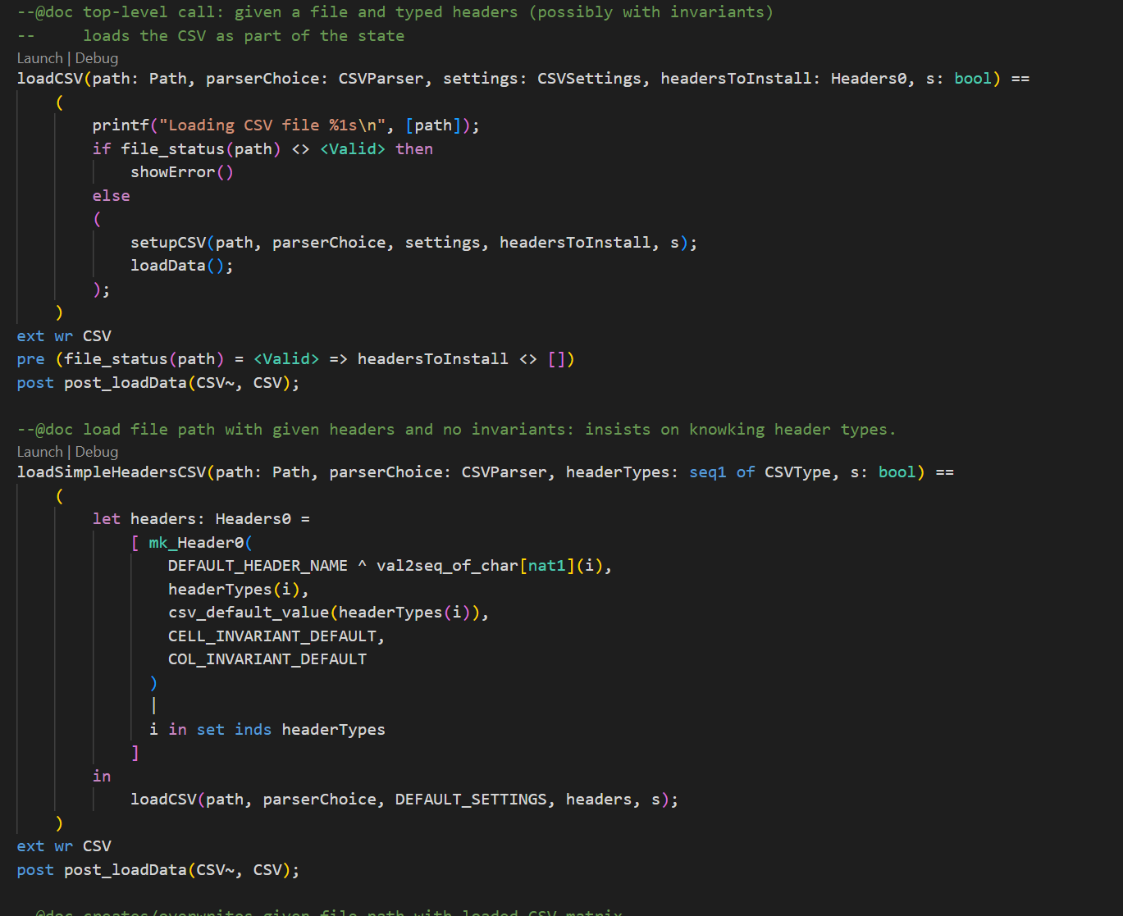
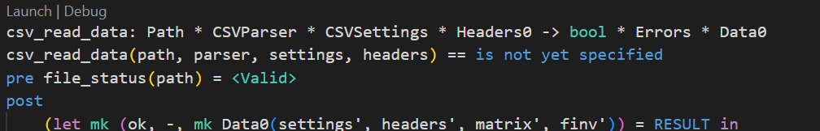
Simple: Ease of Use
Accessible entry points that abstract from IO native calls
Out-of-the-box setup
Configurable (e.g. CSV settings)
Allows direct native calls for better extensibility and control (3)
Data validation can be
formally specified
1
2
3
Notes:
Multiple library access points
Simple bare-minimum load operation
Configurable input exposes more advanced features such as the custom invariants
Native enables more micromanagement of data
Option to return data only if valid

Slide 6
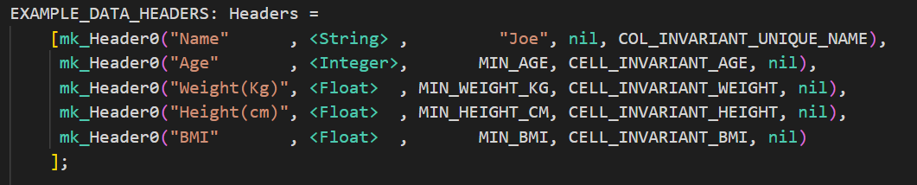
Simple: Configurable Setup
CSV entries strong typing defined through semantic headers as:
Column Name
Datatype
Default Value
Cell invariant
Column Invariant
CSV settings define expected file properties as:
Presence of blank lines
Existence of a header row
Comment string
Notes:
Configurable CSV Setup
Specify CSV col Typing through the header
Default value in the presence of “multiple-commas” in a single row
Specify Cell/Type invariant as well as column inv
Parser also takes settings that define general properties for the file

Slide 7
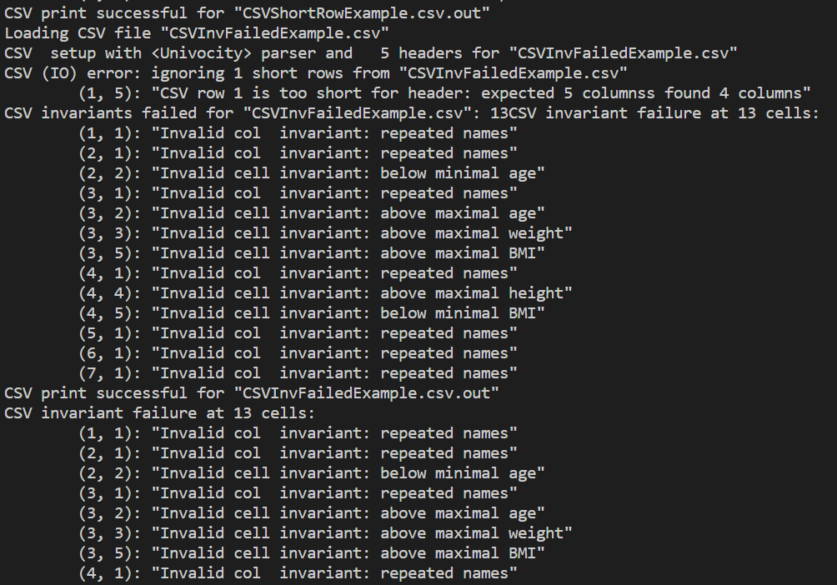
Simple: Reporting
Simple and descriptive reporting
Short rows (i.e. not enough columns)
Declared type violations (e.g. string for nat)
User defined invariant violations
Provides cell locations for correction
Striving to have a strongly-typed CSV

Slide 8




Accurate
Checks on imported data
Short rows
Declared header type validation
User defined invariants
Cell invariants
Column invariants
Row invariants
File Invariants
Lambda abstractions capture invariants as record fields
Invariants return a Reason
1
2
3
4
Notes:
Important to explain the nature of the type signature and how they work
CellInv: Declared header type + value
ColInv: Full header and transposed row (column view)
RowInv: Full header and row view
FileInv: Full header and full CSV matrix
What’s a reason and how one encodes success / failure etc.

Slide 9
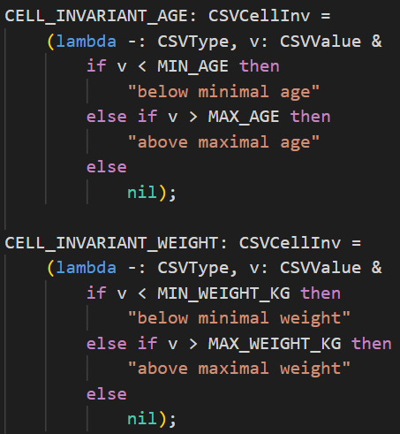
Accurate: Cell Invariant
Invariants that act upon cells directly
Allows for cell validation
Embedded with the header
Examples
Upper/lower bounds
Cell text validation
Specific value enforcement
etc…
Notes:
* Explain what the examples mean

Slide 10
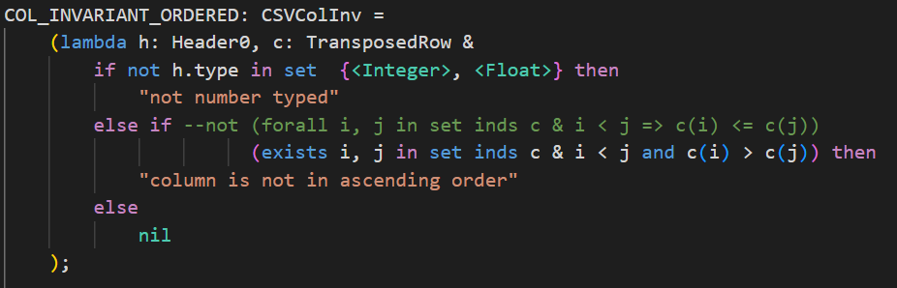
Accurate: Column Invariant
Column-wide invariant
Allows for validation per header across rows
Embedded with the header
Example
Uniqueness
Dependence
Notes:
* Explain what the examples mean

Slide 11
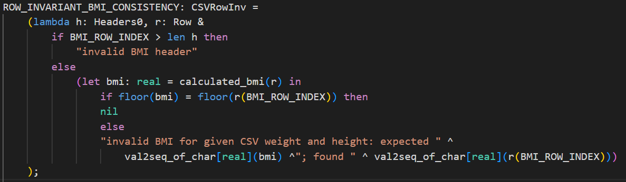
Accurate: Row Invariant
Row-wide invariant
Allows for validation per row across all headers
Examples
Consistency
Dependence
Redundance
Notes:
* Explain what the example qualifier mean

Slide 12
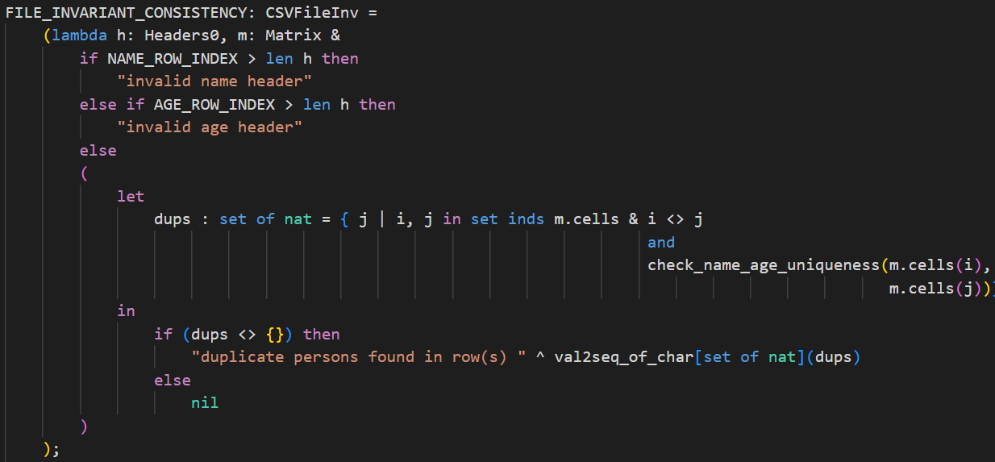
Accurate: File Invariant
Invariant across all CSV cells
Example
Dependence
Redundancy

Slide 13
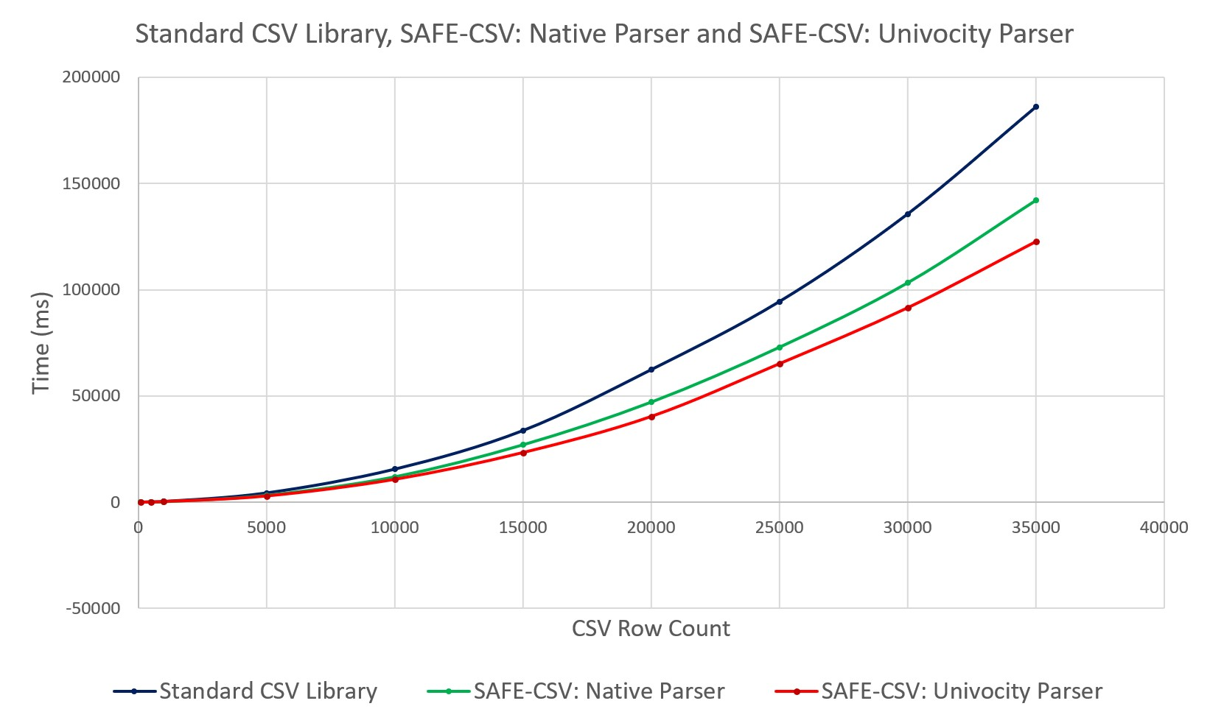
Fast
Notes:
* Explain why speed is important (for us)

Slide 14
Effective
Multiple CSV format variants
Better tolerance to CSV format variability (e.g. CSV UTF8, MS-DOS, Mac, etc.)
Delegate CSV format type to parsers (e.g. formalisation of CSV format itself)
Ease of use: use of VDM state and operations as entry points
Improved validation, error handling and reporting
Faster performance through multiple CSV parsers

Slide 15
Effective
Tested on multiple CSV format variants
CSV UTF8, MS-DOS and Mac
Applied to multiple domains
ScubaTx organ preservation device medical device logs
UNOS (United Network for Organ Sharing) lung transplant history logs
EMV payment system transaction logs
Neonatal dialyser finite state machine control system definitions
Etc.

Slide 16
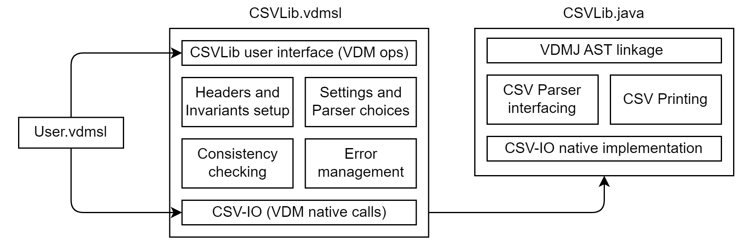
Library Architecture

Slide 17
Future Work
Implementation of debugging environment
Improved variety of CSV formats
Nested CSVs
CSV Settings
More CSV data types
Multiple CSV headers per file

Slide 18
Thanks for Listening

